Slide 1

SDG 15.4.1: Tracking Mountain Biodiversity
Amina Ly
July 23, 2021
Notes:
Thank you for the introduction Kirsten. I’m going to talk a little today about a project I’ve been working on with global mountain biodiversity assessment group on tracking biodiversity and protected areas

Slide 2
Mountain biodiversity is under extreme threat across the globe
Rahbek et al. 2019
Notes:
Mountain biodiversity is under threat across the world
While mountains only cover 25% of all land area, these regions are home to more than 85% of the world’s species of amphibians, birds, and mammals,
many entirely restricted to mountains
Across the world, there are scientists, policy makers, and ecologists & others committed to protecting and tracking biodiversity

Slide 3
How do we track global progress toward protecting mountainous key biodiversity areas around the world?
Notes:
So as part of the UN sustainable development goals (specifically goal 15.4), we’re interested in exploring our progress towards protecting these regions
We now have a new dataset that has high resolution mountain mapping and it allows us to focus on mountainous regions

Slide 4
Key Data Sources Include:
Global Mountain Biodiversity Assessment Mountain Inventory (GMBA)
Key Biodiversity Areas (KBAs)
WCMC World Database on Protected Areas (WDPA)
Northern Wasatch Range
(Western Rockies)
Notes:
To do this calculation, we relied on three key datasets .
GMBA - these are our mountains as you (in this example the northern Wasatch range
KBAs – identified key biodiversity areas. Areas identified as being important to protecting biodiversity
WDPA – list of historic and current protected areas
We were able to combine these three datasets together to create a new dataset that offers some insight into our progress

Slide 5
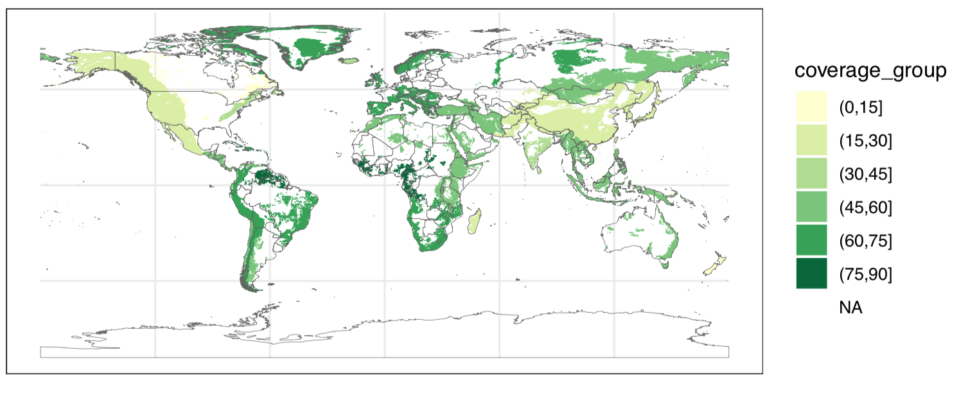

Percent Coverage of Key Biodiversity Areas by Protected Areas as of 2020
Communicating current progress on protecting mountainous regions
Notes:
The first step is to communicate the current progress/state of protected hotspots in alpine regions
Here are some aggregated results, you’ll see on the west coast of the US with the sierras and rockies only about 15-30% of the hotspots are currently protected, while throughout the andes we’re closer to 60-75% coverage.
We will also be able to see the evolution of coverage through time, and explore which times were most important for increases in protections

Slide 7
A whole new set of possibilities has opened up for us explore progress on protections, and identify new threats to alpine biodiversity
Notes:
With this data set

Slide 8




Making this strategy accessible and reproducible for individual use
Online interface to communicate results
Combining this dataset with historic and projected climate data to explore climate change vulnerability
Notes:
What is the future of this dataset?
1. make sure others can access and replicate this standard. Starts with having a public github repo
2. the creation of a web app for people to explore the result of the data. For those familiar, RStudio allows you to do this using by creating a shiny application
3. and finally we can combine this dataset with climate data to explore climate change vulnerability in these areas. This can be done using current/historic data from satellites or even using future projections/scenarios

Slide 9


Thank You!
Global Sustainability Scholars
Global Mountain Biodiversity Assessment (GMBA) Team:
Davnah Urbach; Mark Snethlage; Jonas Geschke
Birdlife International
Ashley Simkins
UNEP WCMC
Cristina Lazaro
aminaly@stanford.edu
@amina6_26
Notes:
Amina, Stanford PhD Candidate; throughout this process I’ve learned so much about the incredible amount of man power that goes into these seemingly simple calculations and tracking projects, and how important collaboration and communication is towards realizing our shared goals.

